Slide 1


Slide 2

Tutorial 4 Sections 009/010
TA: Greydon Gilmore
Physiology 2130
Oct 1st ,2019

Slide 3

Your TA reminding you…
1st Peerwise assignment (1.5%)
Post 2 MC questions: due Oct 16th @ midnight
Answer 5 MC questions: due Oct 18th @ midnight
Currently 12 inactive users
Only 17 students completed
1st Quiz (1%)
Opens: Oct 21st @ 4pm
Closes: Oct 22nd @ 4pm
1st Midterm - Oct 25th @ 6pm-7pm (15%)

Slide 4
Today
Group work
Learning Catalytics Quiz
Action potential

Slide 5
Group Work

Slide 6
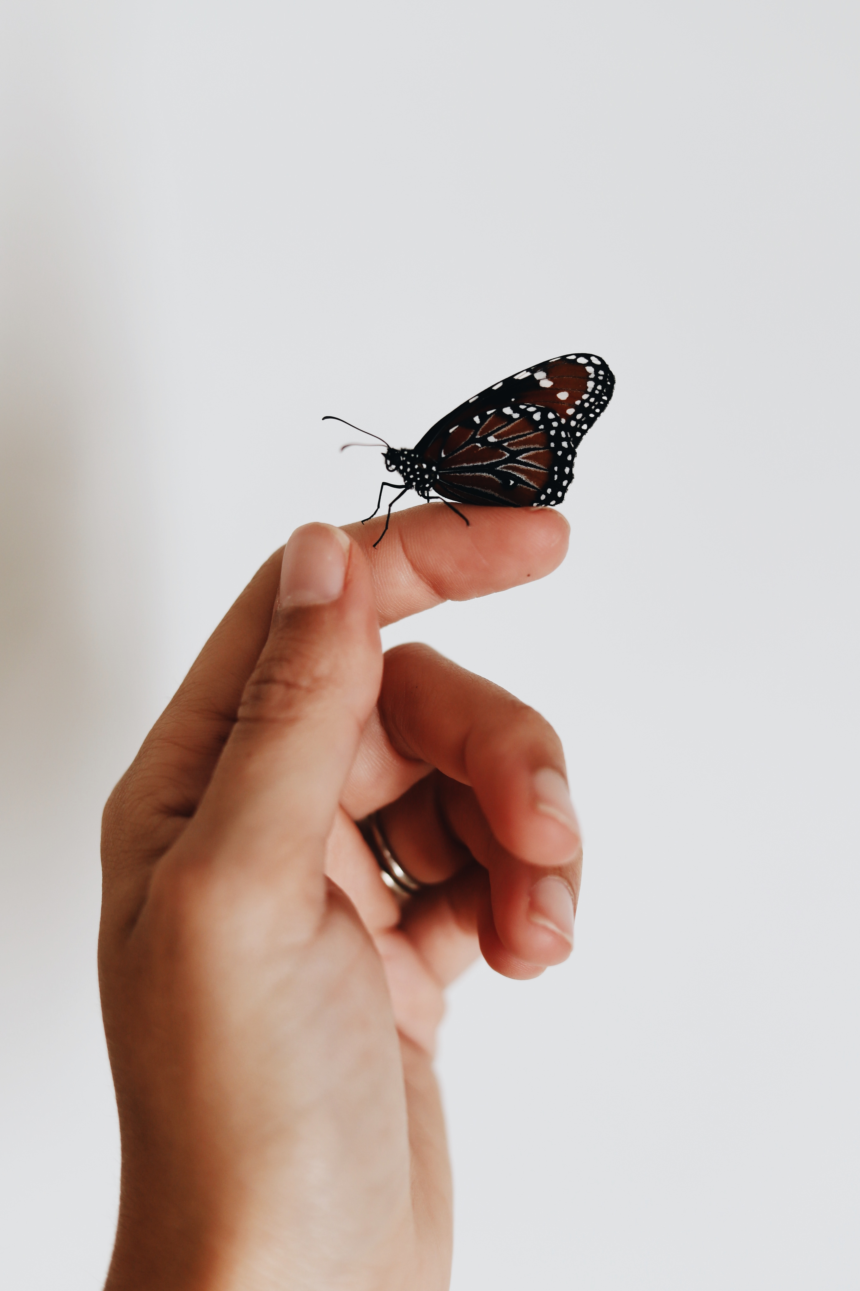
Activity #1: Drawing Sensory Pathway
There is a butterfly fluttering on your left finger.
On the paper provided, first draw the pathway that the information would take to reach the primary somatosensory cortex. Think about the various neurons (i.e. 2O neuron), where they synapse, and where they cross.
After you have drawn the pathway, please indicate what electrical events occur in each neuron, starting with the receptor.
Be specific, what electrical event will occur in each area of the neuron?
If it is a post-synaptic potential, is it inhibitory?
Which touch receptor is this? What channels open in the receptor to cause us to feel the flutter?

Slide 7
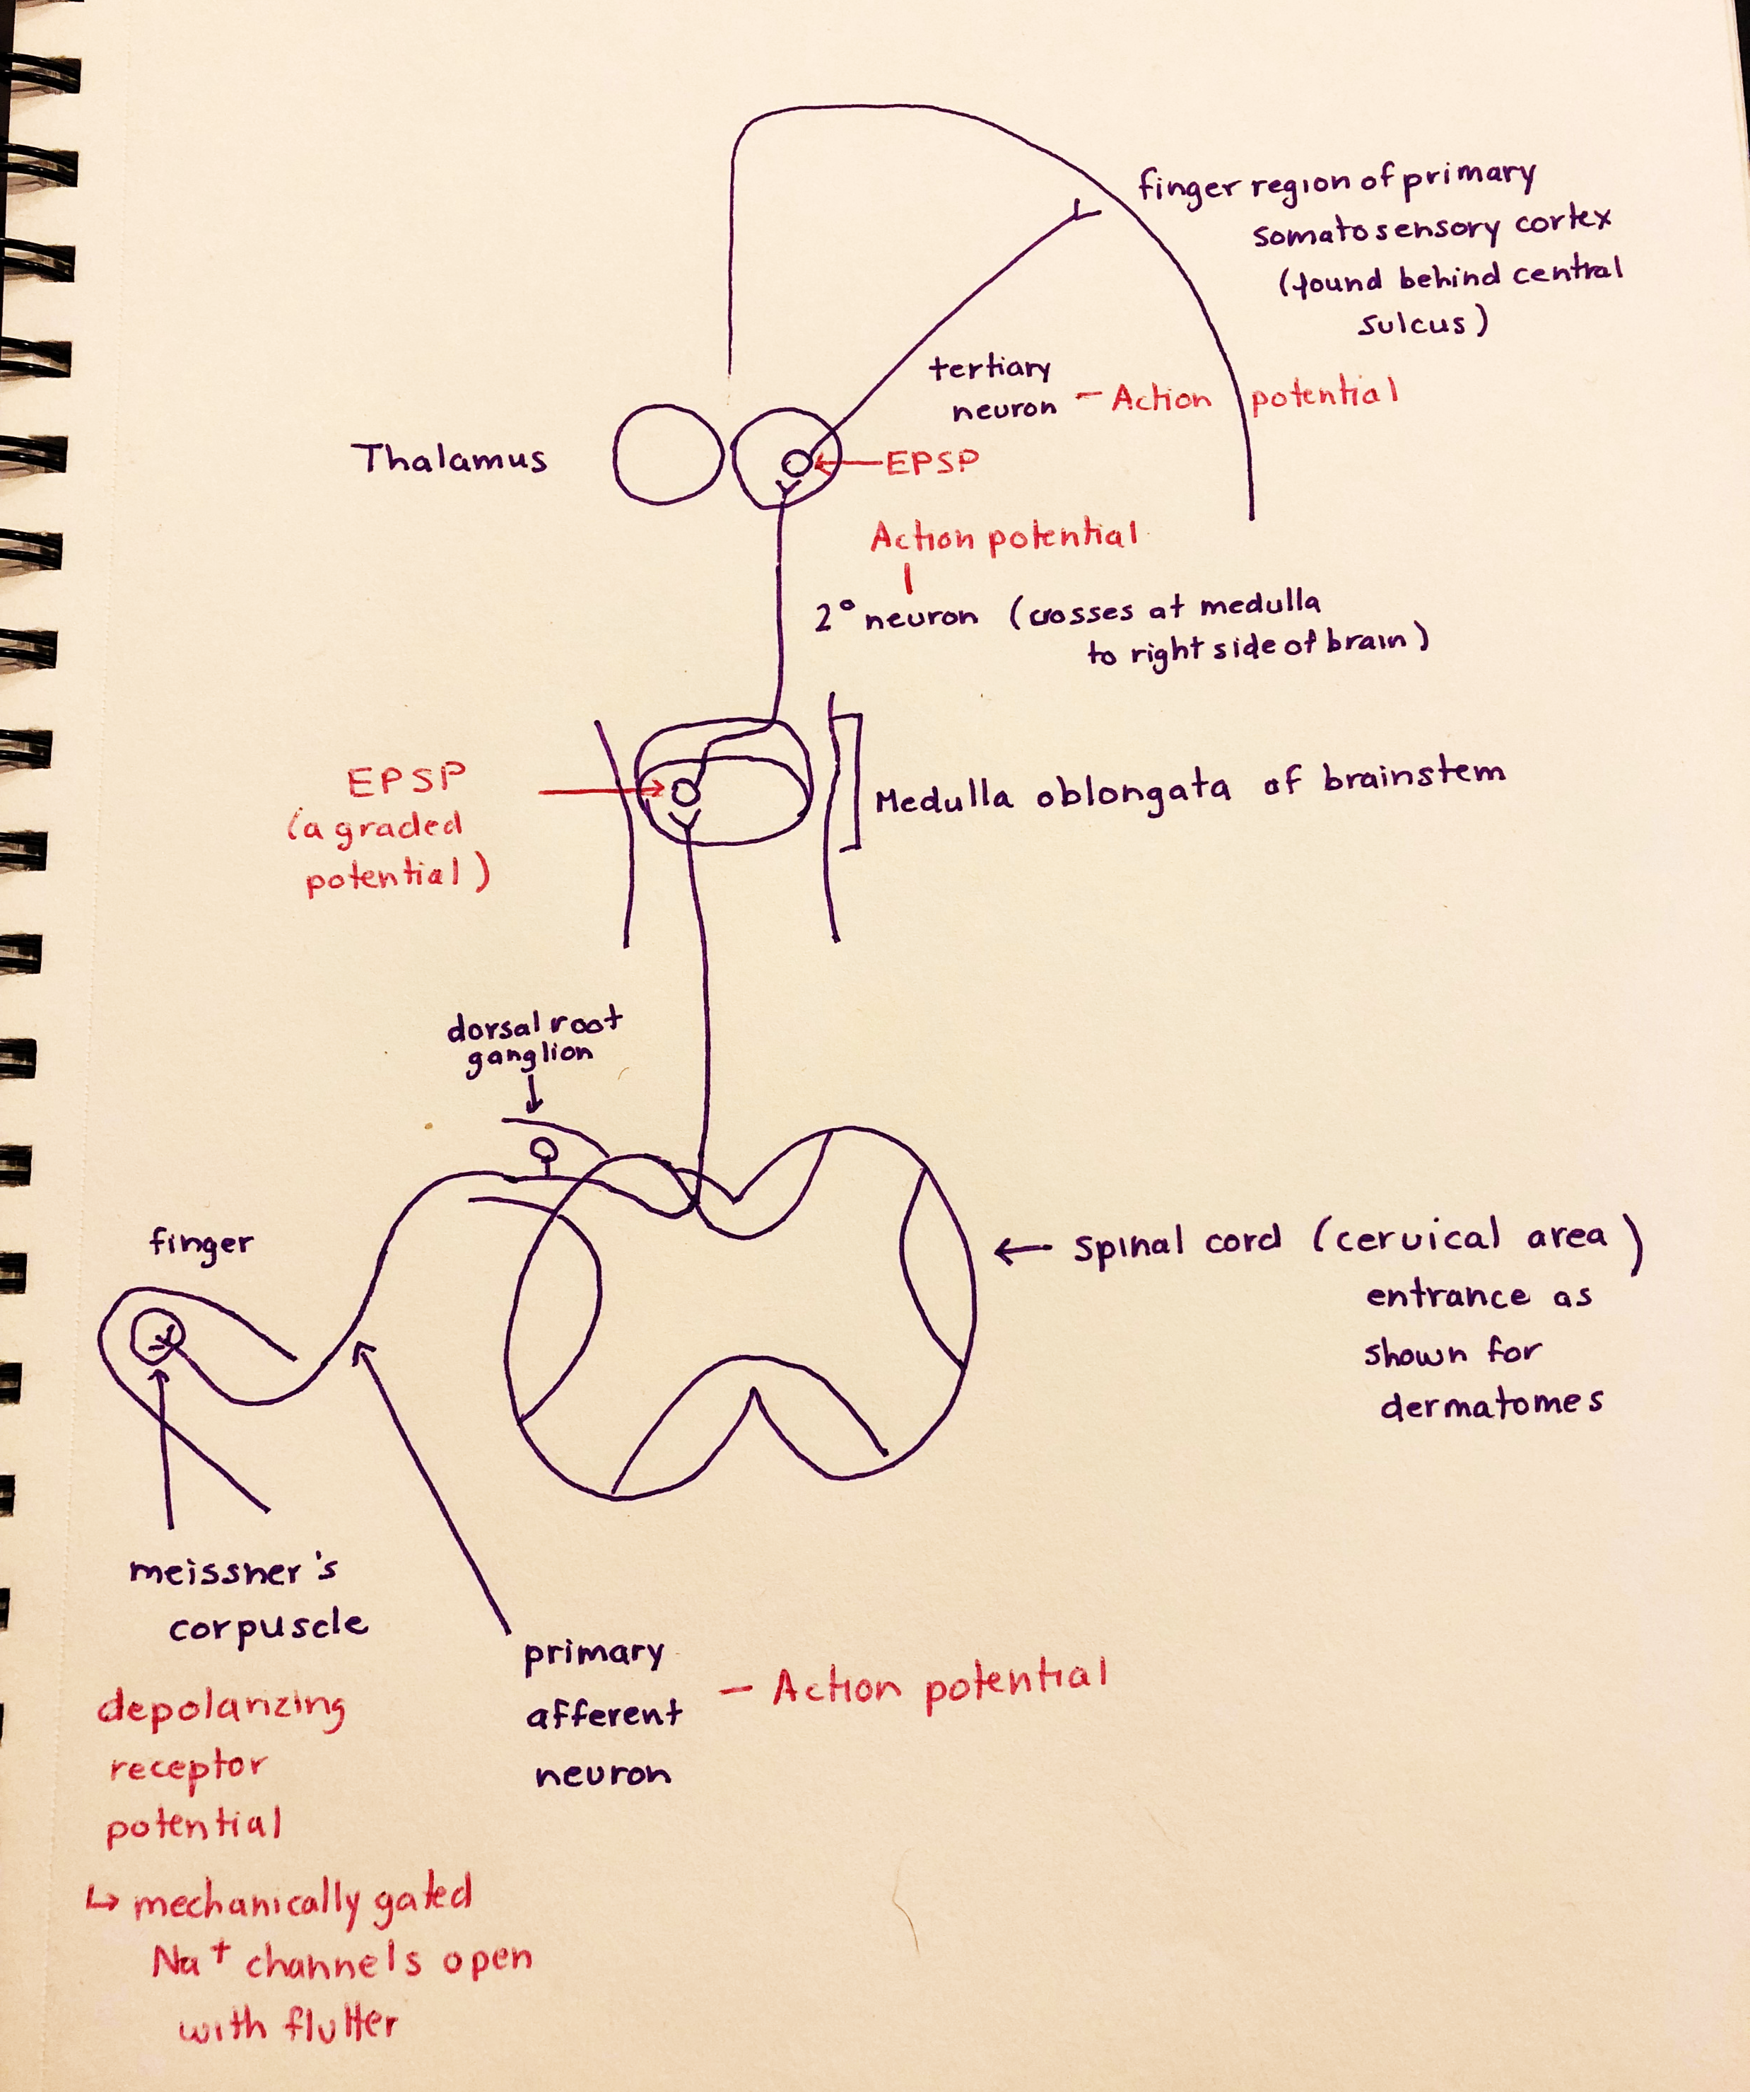
Activity #1: Answer Key

Slide 8

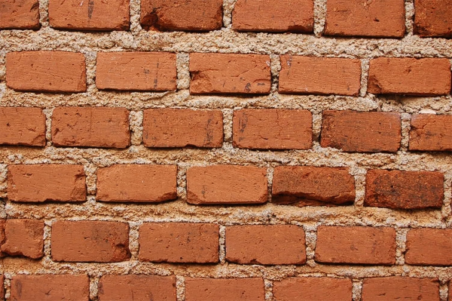
Activity #2: Discussion Time
Imagine rubbing your finger across a pane of smooth glass and then across a brick. What kinds of skin receptors help you distinguish the two surfaces?

Slide 9
Activity #2: Answer Key
Both Meissner's corpuscles (stroking stimulus) and Merkel discs (texture stimulus) are activated when touching the brick
Since you are moving across the rough surface of the brick, you will also activate deep Pacinian corpuscles
Due to the vibrations that are created by the rough texture of the brick
When you are rubbing your finger against the smooth glass pane, only Meissner's corpuscles are activated (again stroking stimulus) because there is no texture

Slide 10
Learning Catalytic Question

Slide 11
Practice Question
Your small dog is standing on your foot. This stimulus created action potentials that went to your somatosensory cortex so you feel it. But how were those action potential generated?
Hint: touch uses mechanoreceptors, which directly activate the dendrite(s) of a sensory neuron. Think about the type of channels these receptors open, which ions move, and how threshold is reached.

Slide 12
Your small dog is standing on your foot. This stimulus created action potentials that went to your somatosensory cortex so you feel it. But how were those action potential generated?
Stimulus type?
→ Mechanical
Channels opened?
→ mechanically-gated channels
What enters/where?
→ Na⁺ enters at dendrites
What happens?
→ graded potentials summate, if threshold reached (- 55mV) then AP fired at “trigger zone”

Slide 13
Your small dog is standing on your foot. This stimulus created action potentials that went to your somatosensory cortex so you feel it. But how were those action potential generated?
What part of spinal cord receives info?
→ Lumbar 5/Sacral 1
What spinal cord division carries info to brain?
→ Dorsal
What part of brain does this info end up?
→ Medial somatosensory cortex (postcentral gyrus)

Slide 14
The Action Potential
Chapter 1: Dr. Woods
pp.

Slide 15
Which of the following structures are correctly associated with their function?
Dendrites send outgoing signals
Myelin insulates axons to prevent ion/current leak
There are no ion channels at the Nodes of Ranvier
There are no organelles at the soma

Slide 16
Which of the following structures are correctly associated with their function?
Dendrites send outgoing signals
Myelin insulates axons to prevent ion/current leak
There are no ion channels at the Nodes of Ranvier
There are no organelles at the soma

Slide 17
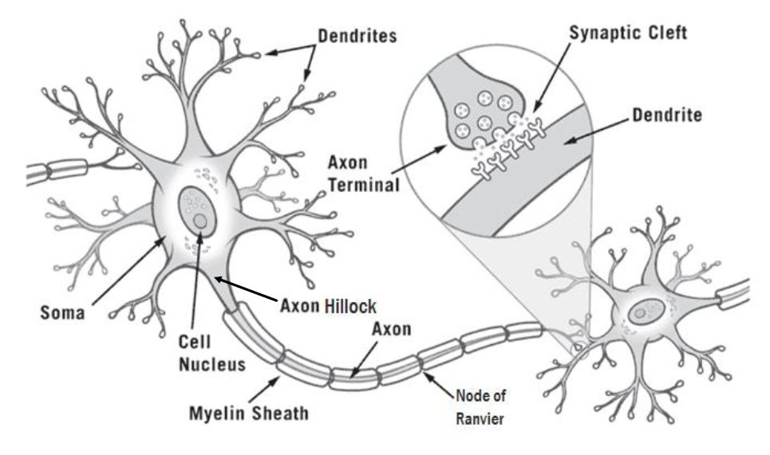
The Neuron

Slide 18
Key Events and Their Locations
Incoming information received by the dendrites
Graded potentials occur in the dendrites/soma
An action potential is fired at the axon hillock if threshold is met
The action potential travels along the myelinated axon via salutatory conduction
The action potential arrives at the axon terminal of the pre-synaptic cell and the message is passed to the post-synaptic cell

Slide 19
What is a main difference between a graded potential and an action potential?
Graded potentials do not experience current leak, whereas action potentials do
Graded potentials travel a long distance, whereas action potentials travel a short distance
Graded potentials occur at the soma, whereas action potentials start at the axon hillock
The amplitude of the graded potentials is not proportional to the stimulus strength, whereas the amplitude of action potentials is proportional to the stimulus strength

Slide 20
What is a main difference between a graded potential and an action potential?
Graded potentials do not experience current leak, whereas action potentials do
Graded potentials travel a long distance, whereas action potentials travel a short distance
Graded potentials occur at the soma, whereas action potentials start at the axon hillock
The amplitude of the graded potentials is not proportional to the stimulus strength, whereas the amplitude of action potentials is proportional to the stimulus strength

Slide 21
Graded Potentials vs. Action Potentials
Graded Potentials | Action Potentials
Occur at dendrites/somas | Occur at axon hillock
Caused by mechanical or chemical-gated channels | Caused by voltage-gated channels
Can be a depolarization or hyperpolarization | Always a depolarization
Amplitude of potential is directly proportional to stimulus strength | All or nothing–Amplitude of potential is constant no matter the stimulus strength
Travel short distances | Travel long distances

Slide 22
Depolarization is caused by the opening of ____, causing ___ to flow ___ the cell.
VG Na+ channels; Na+ ions; into
VG Na+ channels; Na+ ions; out of
VG K+ channels; K+ ions, into
VG K+ channels; K+ ions, out of

Slide 23
Depolarization is caused by the opening of ____, causing ___ to flow ___ the cell.
VG Na+ channels; Na+ ions; into
VG Na+ channels; Na+ ions; out of
VG K+ channels; K+ ions, into
VG K+ channels; K+ ions, out of

Slide 24
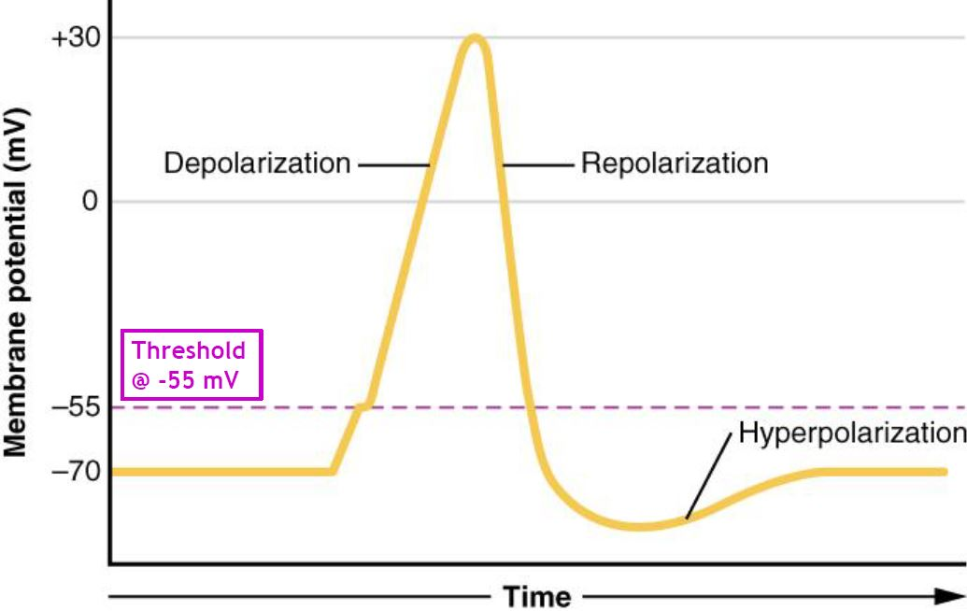
The Action Potential
Depolarization
Potential becomes more +ve
VG Na⁺ C open (fast)
Na⁺ flows into cell
VG K⁺ C start to open (slow)
Repolarization
Potential returns to RMP
VG Na⁺ C inactive
VG K⁺ C fully open
K⁺ flows out of cell
Absolute Refractory Period
Hyperpolarization
Potential becomes more –ve than RMP
VG Na⁺ C close
VG K⁺ C start to close (slow)
RMP
VG Na⁺ C close
VG K⁺ C fully closed

Slide 25
Propagation of The Action Potential
Chapter 1: Dr. Woods
pp.

Slide 26
Propagation of the AP
Myelin prevents ion/current leakage and allows for rapid saltatory conduction
Ion channels are concentrated at Nodes of Ranvier
The Na⁺ ions flow down the axon (like charges repels and opposites charges attract)
This brings the next segment of the axon to threshold and an AP is fired

Slide 27
Propagation of the AP
Initial stimulus @ soma
Threshold is met @ axon hillock and AP is fired
Depolarization (Na⁺ flows into the cell)
Na⁺ flows along the axon
That Na⁺ brings the next segment to threshold and AP is fired
Depolarization of next segment
(Na⁺ flows into the cell)
Repolarization of initial segment
(K⁺ flows out of the cell)

Slide 28
Which of the following events take place at a chemical synapse?
VG Ca2+ channels open, allowing Ca2+ to flow out of the cell
VG Ca2+ channels open, allowing Ca2+ to flow into the cell
Neurotransmitters travel from the post-synaptic cell to the pre-synaptic cell
Neurotransmitters travel from the pre-synaptic cell to the post-synaptic cell
If only 1, 2 and 3 are correct
If only 1 and 3 are correct
If only 2 and 4 are correct
If only 4 is correct
If ALL are correct

Slide 29
Which of the following events take place at a chemical synapse?
VG Ca2+ channels open, allowing Ca2+ to flow out of the cell
VG Ca2+ channels open, allowing Ca2+ to flow into the cell
Neurotransmitters travel from the post-synaptic cell to the pre-synaptic cell
Neurotransmitters travel from the pre-synaptic cell to the post-synaptic cell
If only 1, 2 and 3 are correct
If only 1 and 3 are correct
If only 2 and 4 are correct
If only 4 is correct
If ALL are correct

Slide 30
Synapse
What happens to extra neurotransmitters?
Recycled into axon terminal
Degraded by enzymes
Diffuse out of cleft
What happens to the post-synaptic cell?
If Na+ channels open: EPSP
Na⁺ into cell
Depolarization of post-synaptic cell (graded potential towards threshold) If K⁺ or Cl⁻ channels open: IPSP
K⁺ out of cell or Cl⁻ into cell
Hyperpolarization of post-synaptic cell (graded potential away from threshold)

Slide 31

Firing Neurons From Human Brain!
Subthalamic Nucleus
Globus Pallidus Externa
Globus Pallidus Interna
What caused this sound?

Slide 32
Next Tutorial (Oct 8th)
Nervous system overview
Touch
Sensory System

Slide 33
What Questions Do You Have?
You can ask in the Owl forums as well!
Also anonymously ask questions in the online dropbox!!

